Slide 1
English Phonetics
ENGL-238
2019 Fall

Slide 2
Mid and final exams (open book)
1 page long class summary (by Sunday midnight)
Intermittent assignments
Praat, Python(Jupyter)

Slide 3
English consonants & vowels

Slide 4
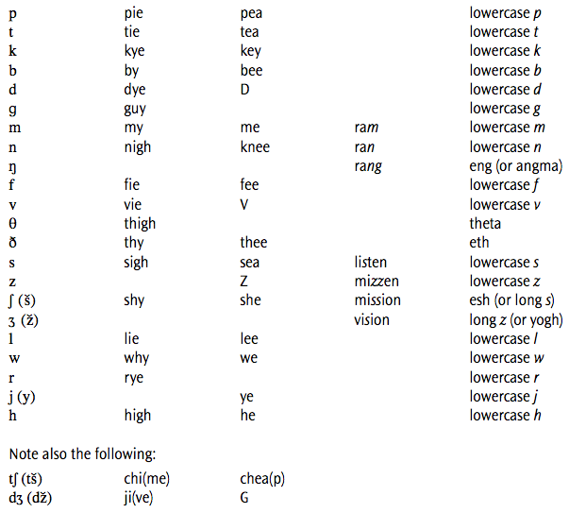
English consonants

Slide 5
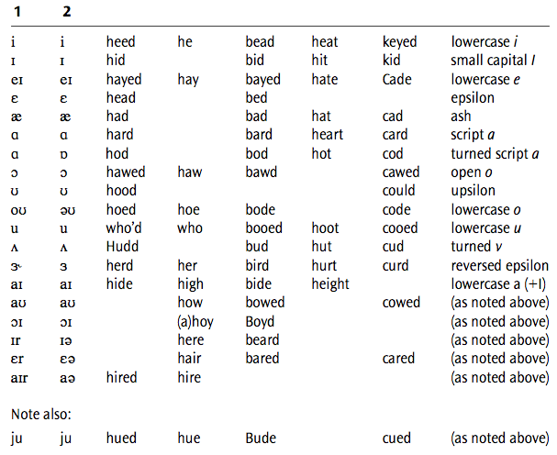
English vowels
monophthongs
diphthongs

Slide 6
Phonetics
A study on speech
How speech is described
Articulatory phonetics (from mouth) ← the most primitive
How to produce speech
Acoustic phonetics (through air)
How to transmit speech
Auditory phonetics (to ear)
How to hear speech

Slide 7
Articulation

Slide 8
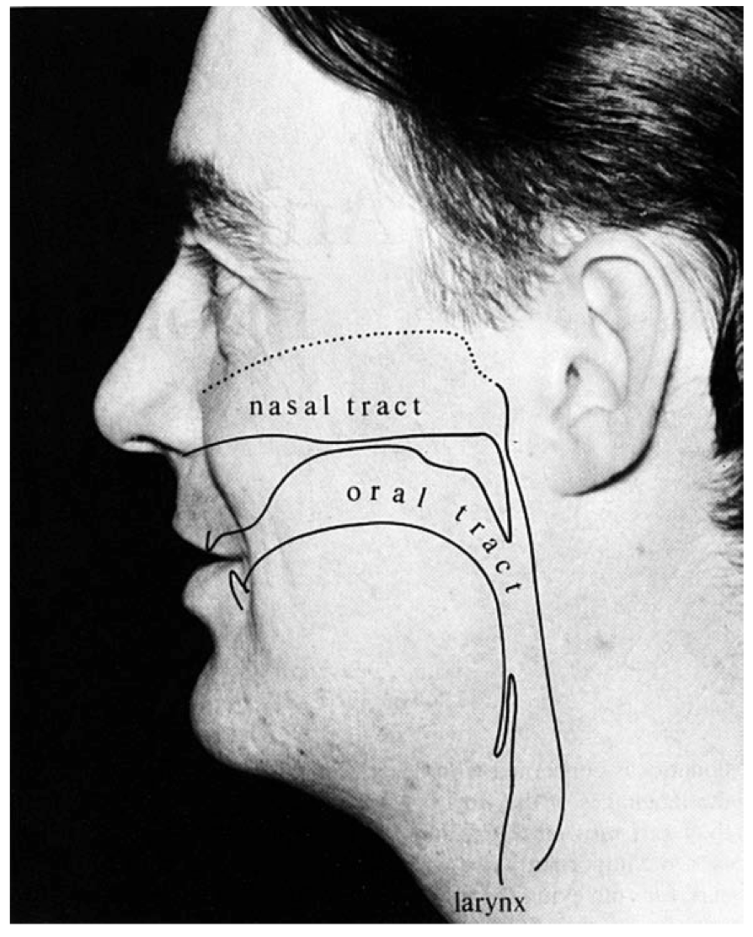
The vocal tract
nose
ear
pharynx
larynx

Slide 9
The vocal tract
비
이
인
후

Slide 10
The vocal tract
鼻
耳
咽
喉

Slide 11
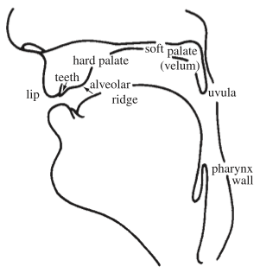
Vocal tract (upper)

Slide 12
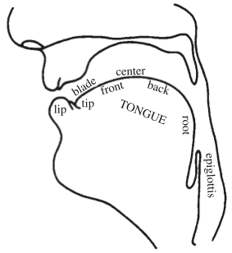
Vocal tract (lower)

Slide 13
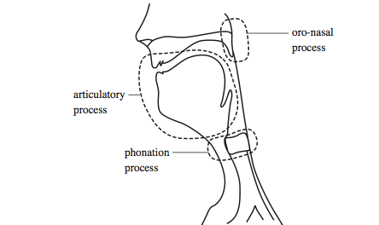
5 speech organs =constrictors =articulators
velum
= soft palate
lips
tongue
body
tongue
tip
larynx
= voicebox

Slide 14
Phonation process in larynx

Slide 15
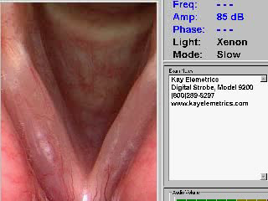
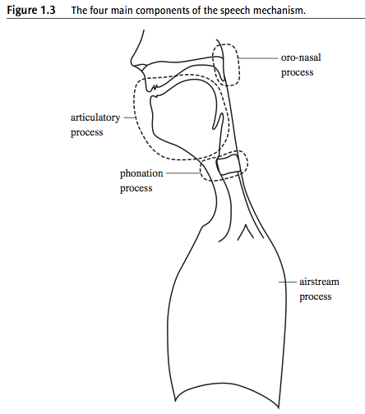
Vocal cords vibration

Slide 16
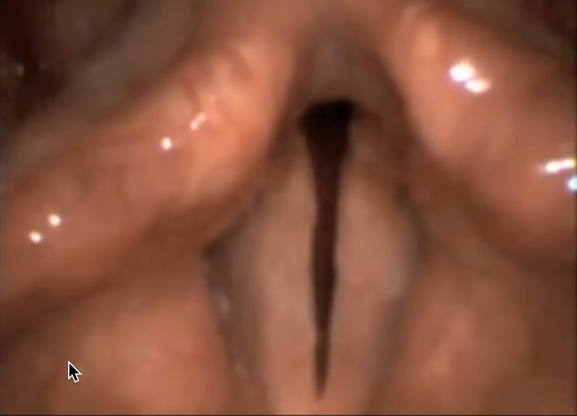
Slow motion of vocal cords vibration

Slide 17
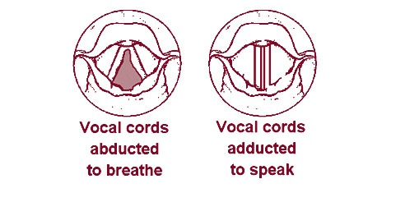
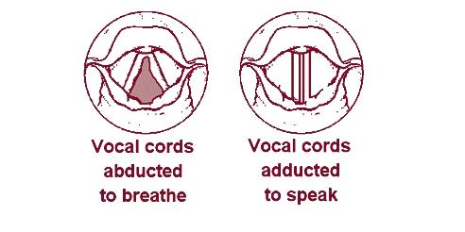
Larynx = voicebox
voiced: can feel vibration
e.g. v, z, l, m, a, i, …
voiceless: can’t feel vibration
e.g. f, s, k, p, h, …

Slide 18
Oro-nasal process in velum

Slide 19
Whether velum lowered
nasals: m n ng …
when breathing?
up
down

Slide 20
Articulatory process in lips / tongue tip / tongue body

Slide 21
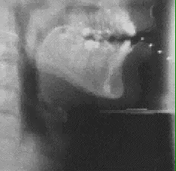
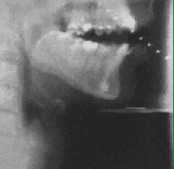
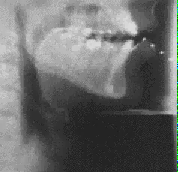
lips
tongue tip
tongue body

Slide 22
Control of constrictors(articulators)
By CL and CD

Slide 23
Each constrictor needs to be more specific in geometry
Constriction location (CL): where exactly?
Constriction degree (CD): how much exactly?

Slide 24
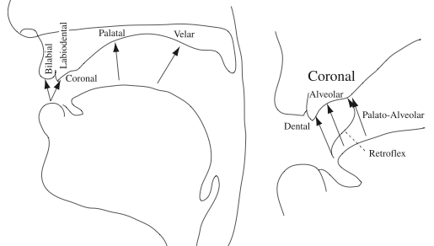
Constriction location (CL)
tongue body
lips
tongue tip

Slide 25
Constriction degree (CD)
upper part
lower part
stops
fricatives
approximants
vowels

Slide 26
How to produce English consonants & vowels?

Slide 27
By specifying constrictors, CD, and CL

Slide 28
From now on let’s call a sound (a consonant or vowel) a phoneme.

Slide 29
Phonemes
Individual sounds that form words
e.g., ‘psycho’ /s aɪ k oʊ/
a combination of speech organs’ actions
lips / tongue tip / tongue body / velum / larynx
phonemes
on
on
on
on
on
p,b,m,f,v,w
θ,ð,t,d,s,z,ʃ,ʒ,l,r
k,g,ŋ,j,vowels
m,n,ŋ
p,f,θ,t,s,ʃ,k,h

Slide 30
Acoustics

Slide 31
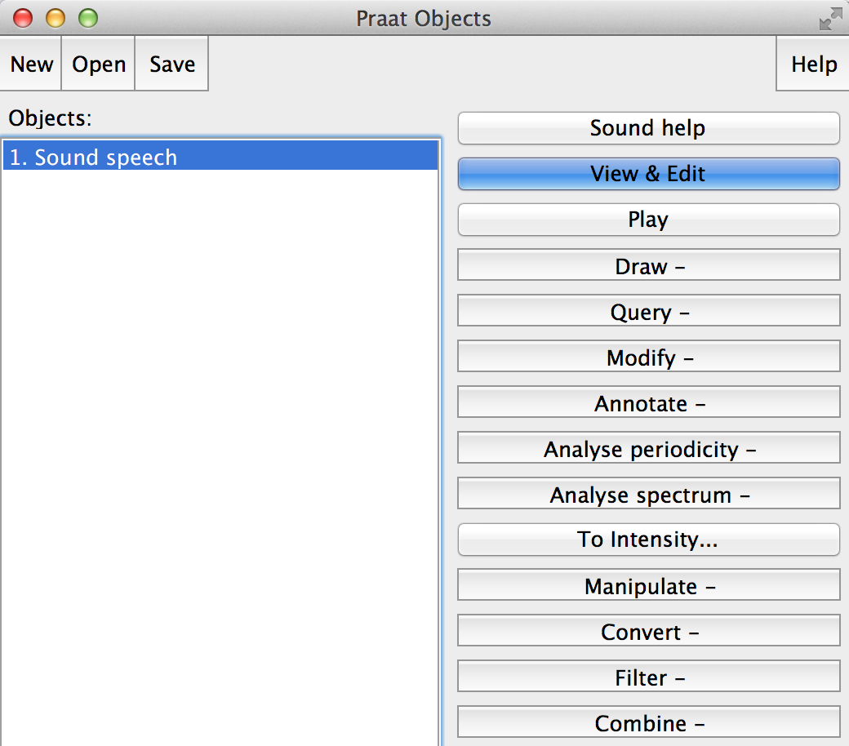
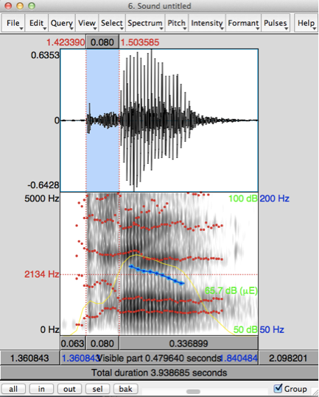
Acoustics in Praat
duration (sec.)
waveform
pitch (Hz)
spectrogram
formant (Hz)
intensity (dB)

Slide 32
Praat
Duration:
select (click and drag on waveform or spectrogram)
read a value (sec.) on the top
zoom in (if not visible)

Slide 33
Praat
Intensity:
show intensity
click on green
read a value (dB) on the right

Slide 34
Praat
Pitch:
show pitch
pitch setting - pitch range
65-200Hz for male speech
145-275Hz for female speech
click on blue
read a value (Hz) on the right

Slide 35
Praat
Formant:
show formants
place the cursor on one of the trajectories
read a value (Hz) on the left

Slide 36
Vowel acoustics
Record yourself with the vowel /a/
Measure pitch using Praat
The number of occurrences of a repeating event per second (Hz)
repeating event = vibration of vocal folds
Repeating? This might remind you of a sine wave!
Let’s create a sine wave (=pure tone) with the same frequency using Praat
Why different in sound quality?
Source & Filter

Slide 37

Source
Sound at larynx
Listen to a sentence from a SiSwati
(Southern Bantu Language; Swaziland)
Listen to the glottal wave recorded from subject's larynx while the sentence is being produced
Doesn’t sound like a pure or simplex tone
A complex tone

Slide 38
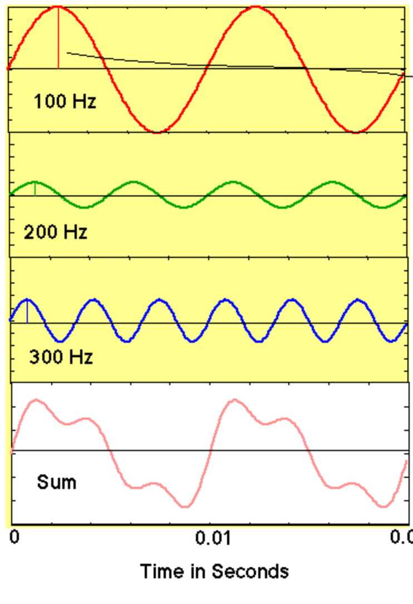
Complex tone in spectrum
Fundamental frequency (F0)
Amplitude
100
Frequency(Hz)
Amplitude
200
Frequency(Hz)
harmonics
Amplitude
300
Frequency(Hz)
Amplitude
100
200
300
Frequency(Hz)

Slide 39
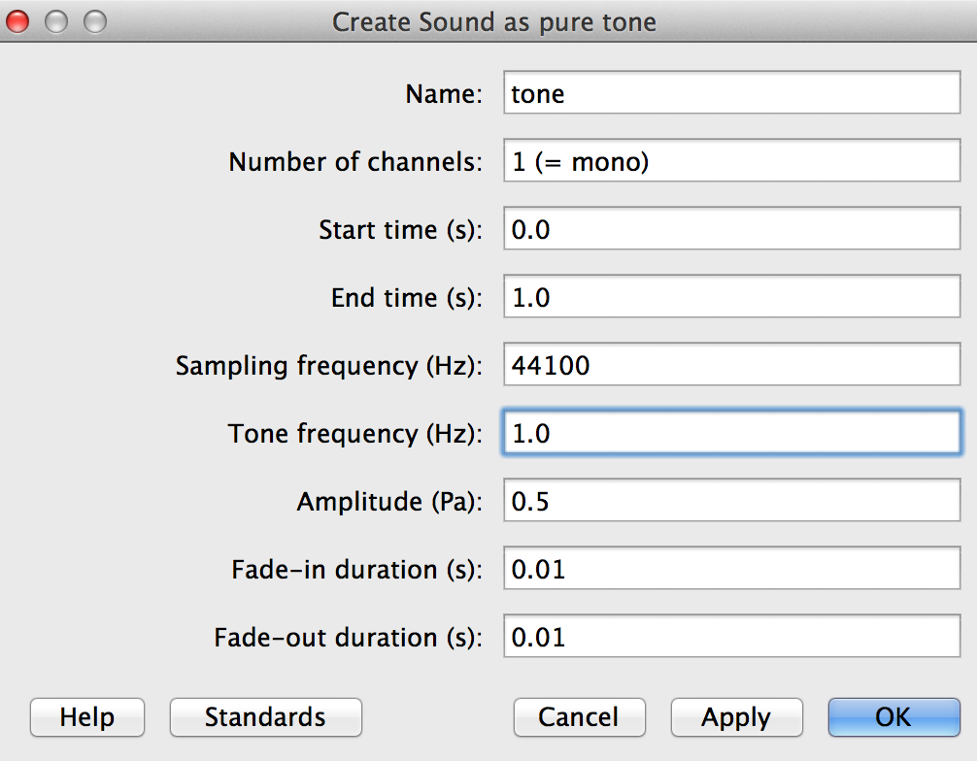
Practice with pure tone & spectrum

Slide 40
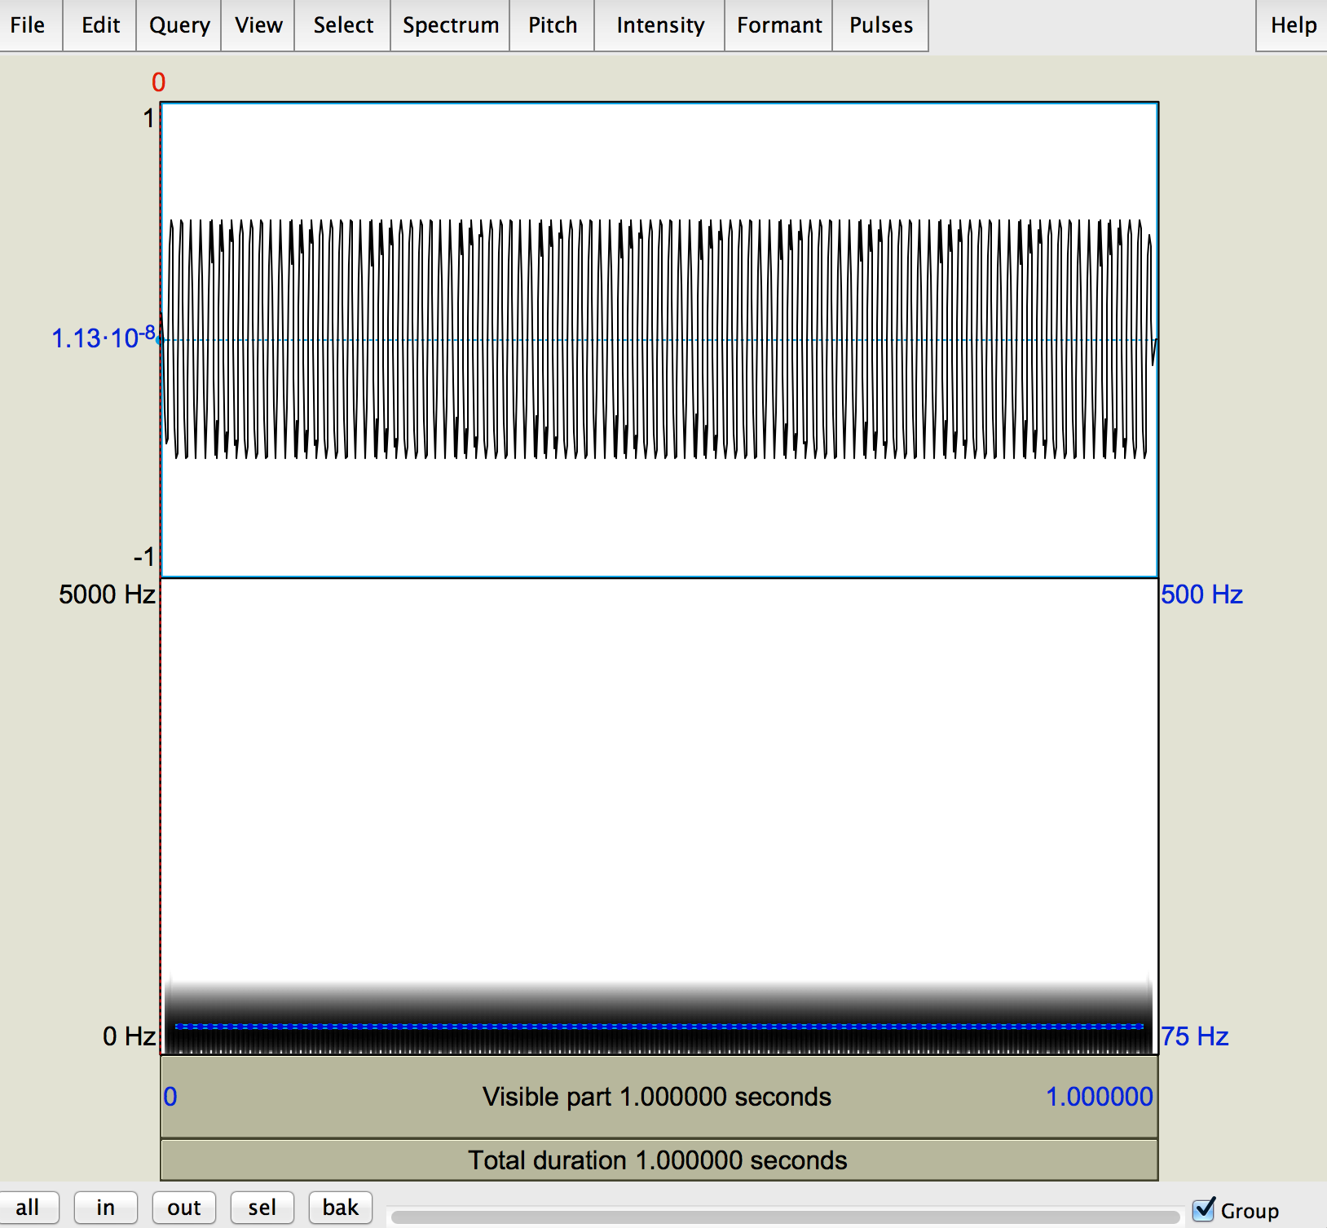
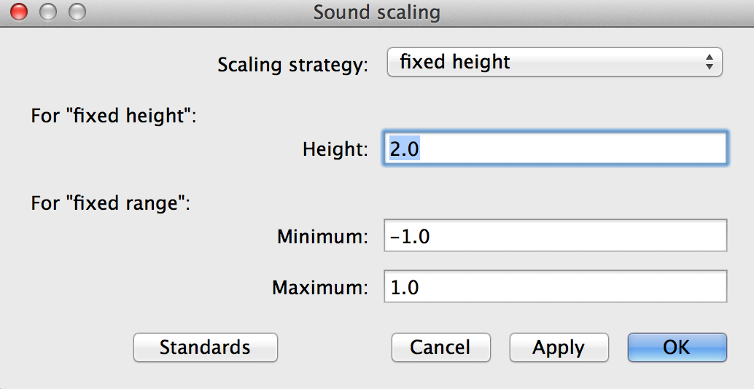
Practice with pure tone & spectrum
View:Sound scaling

Slide 41
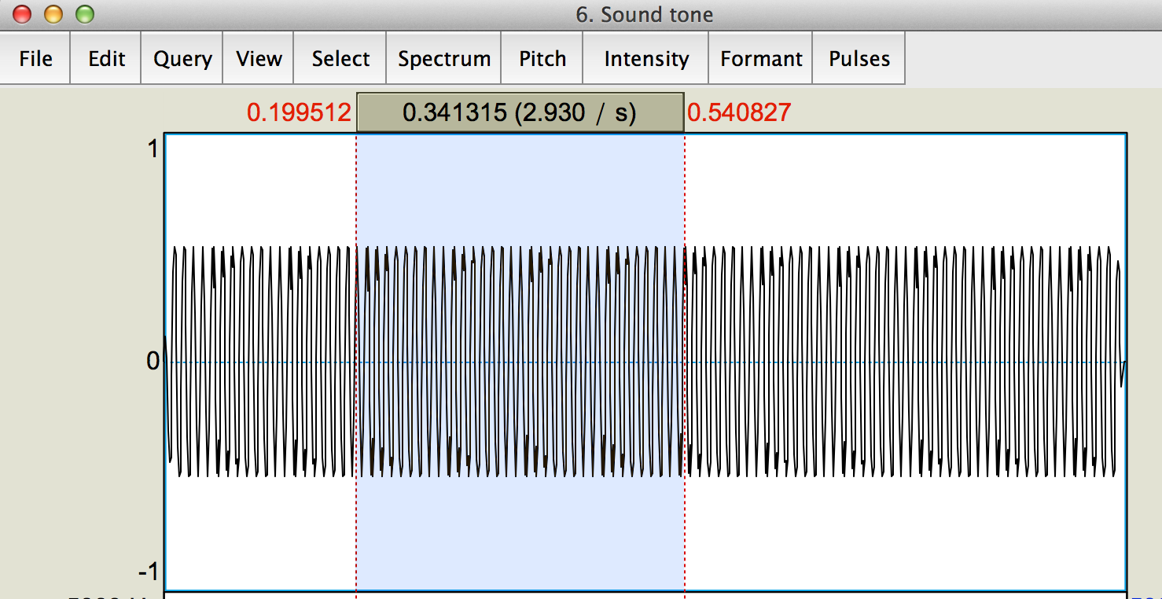
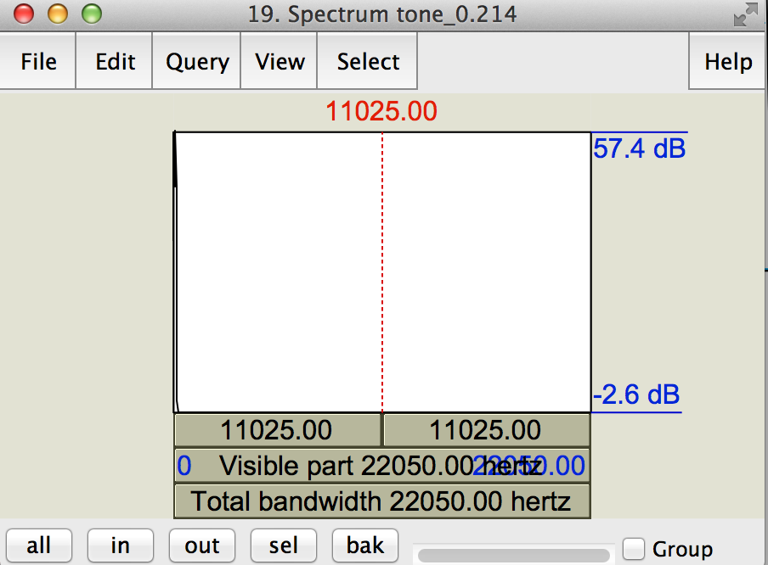
Practice with pure tone & spectrum
Select at least several cycles
Spectrum:Spectral slice
View:Zoom
From 0 to 3000

Slide 42
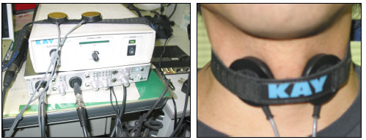
Human voice source
Measured by ElectroGlottoGraph (EGG)
Open vowelEGG.collection in Praat
Compare spectrums between EGG and audio

Slide 43
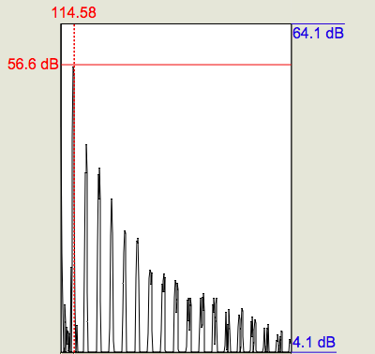
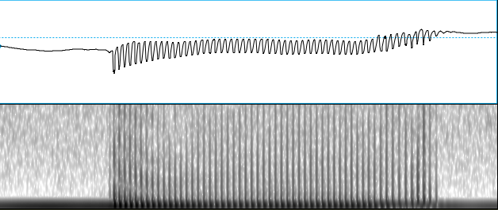
Human voice source
Select several cycles
Spectrum:Spectral slice
F0
x2
x3
amplitude
x4
x5
x6
x7
x8
x9
x10
…….
frequency
gradually decreasing

Slide 44
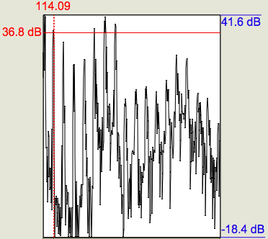
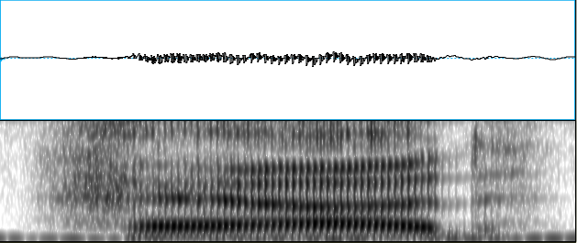
Filtered by vocal tract
Select several cycles
Spectrum:Spectral slice
x6
x7
F0
x5
x2
…….
x4
x3
x9
x8
x10
amplitude
frequency
Jigjagging
with peaks and valleys

Slide 45
source & filter
amplitude
frequency
filtered=carved

Slide 46
source
Human voice source consists of harmonics
A complex tone = sum of pure tones at integer multiples of the lowest pure tone
the lowest pure tone
Fundamental frequency (F0)
rate of vibration of the larynx
the number of opening-closing cycles of the larynx per second
Amplitude of pure tones gradually decreases
Amplitude
100
200
300
400
500
600
700
800
Frequency(Hz)

Slide 47
filter
Compare spectrums between audio and EGG
EGG: gradual decreasing
audio: peaks/mountains and valleys
Because it is filtered by the vocal tract (VT)
peaks/mountains: frequencies VT likes = formants
valleys: frequencies VT does NOT like

Slide 48
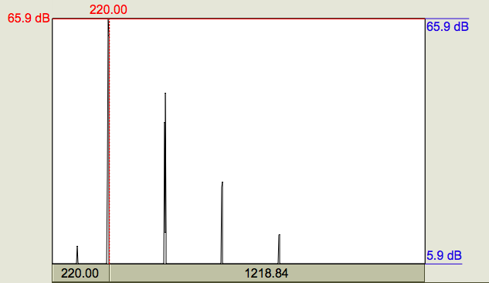
Guitar plucking (similar to voice source)
A complex tone consisting of pure tone components
Decreasing amplitude
spectrum
guitar note A (220Hz)
F0
440.0
660.0
pure tone A (220Hz)
880.0

Slide 49
Synthesizing Source
Praat allows one to synthesize Source
Create harmonics from 100Hz to 1000Hz
with decreasing amplitude by .05

Slide 50
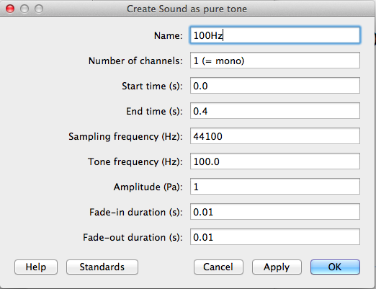
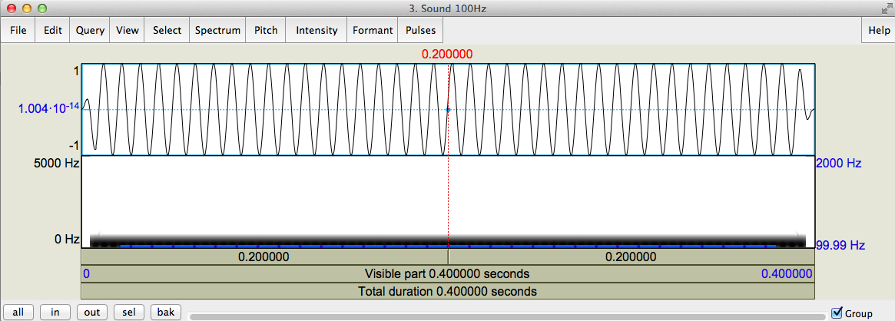
Synthesizing Source
Create Sound as pure tone
Frequency: 100Hz
Amplitude: 1

Slide 51
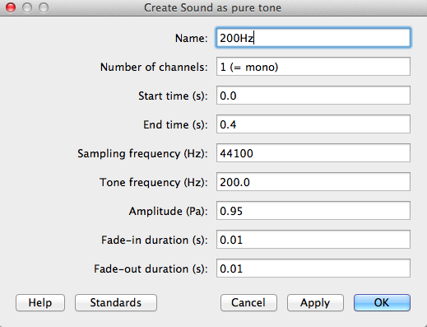
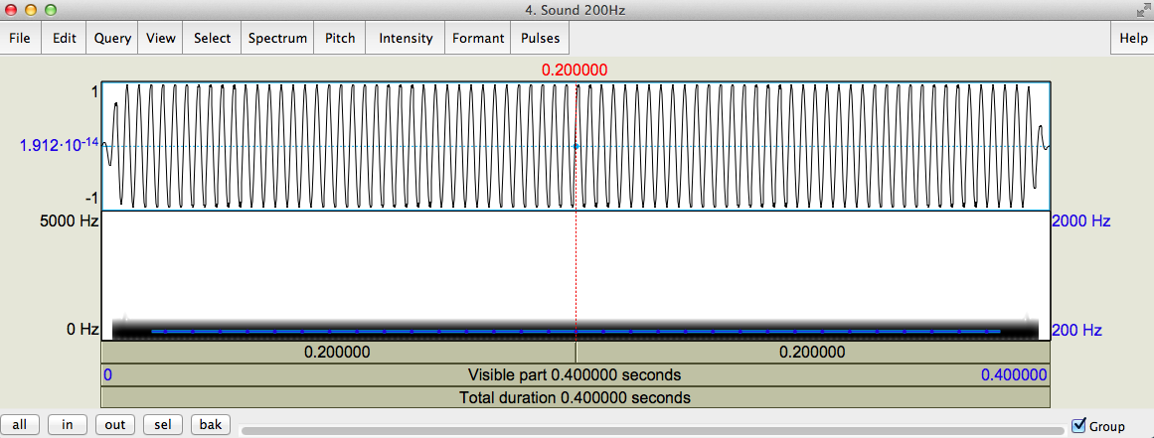
Synthesizing Source
Create Sound as pure tone
Frequency: 200Hz
Amplitude: 0.95

Slide 52
Synthesizing Source
Create pure tones
with different frequencies and amplitudes
Combine to stereo
Convert to mono

Slide 53
Synthesizing Source
Open complex100to1000Hz.collection in Praat
Plot a spectrum
Measure pitch

Slide 54
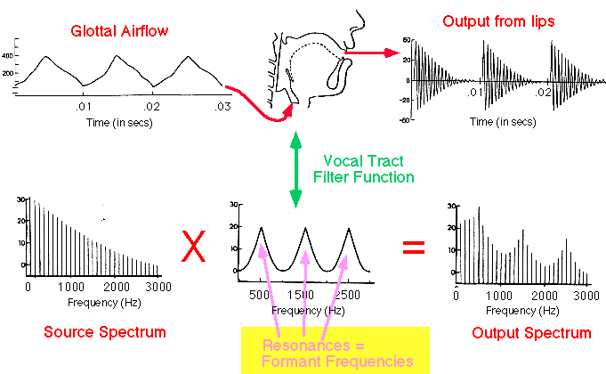
Source-filter theory (from larynx) (by vocal tract) .
Voice Source
waveform
spectrum

Slide 55
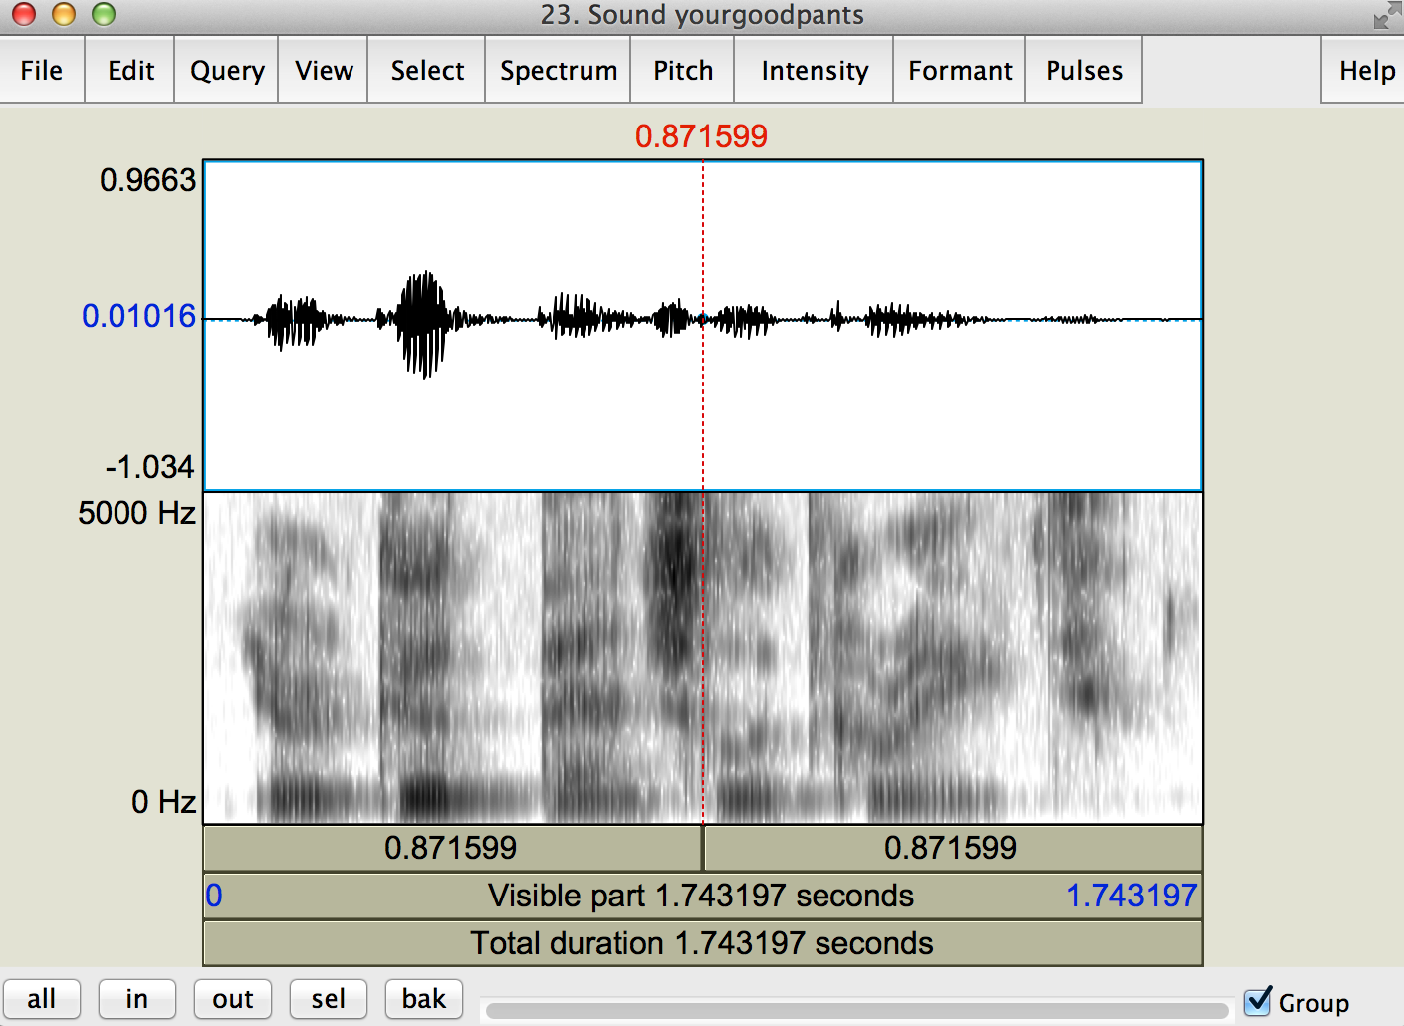
Spectrogram
waveform
Spectrogram
Temporal concatenation of spectrum!!

Slide 56
Spectrogram
F1
F2
F2
F1
Airplane view of temporal concatenation of spectrum!
Dark band: mountains = Formants

Slide 57
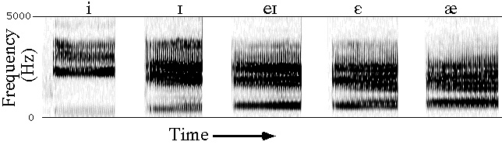

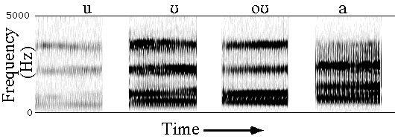
Formants
F1 and F2 are enough to disambiguate vowels.

Slide 58
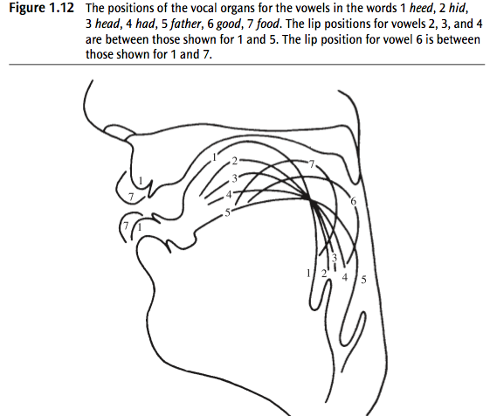
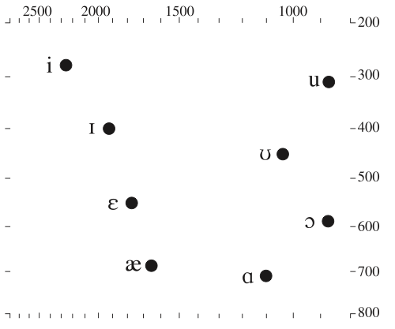
Vowel space
F2
F1
Practice with VowelEditor in Praat

